Slide 1
STRUCTURE OF MATTER
UNIT CELL, BRAVAIS LATTICE
Primitive & Non-primitive Unit cells
Different Lattice symbols
Total no. of atoms in different unit cells
Bravais lattice in three-dimensions

Slide 2
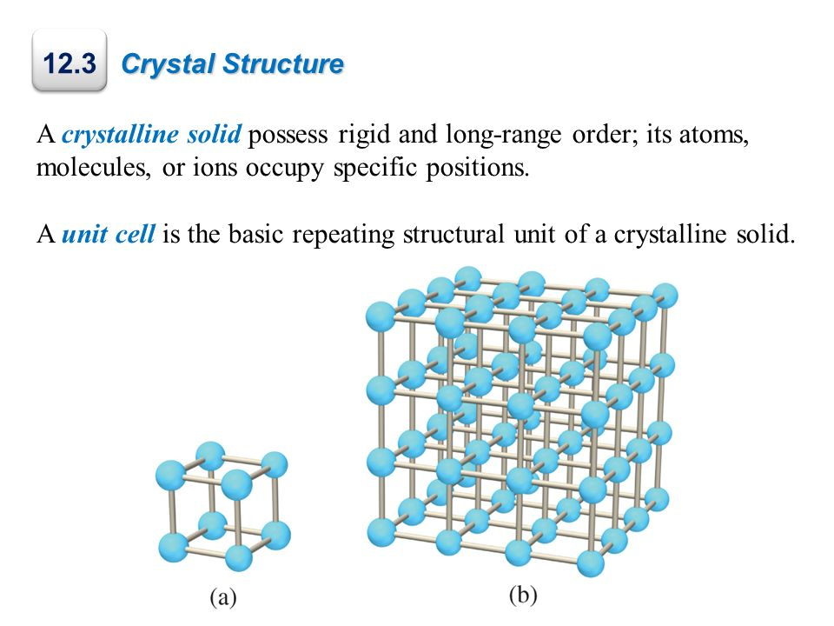
Unit cell
Crystal Structure

Slide 3
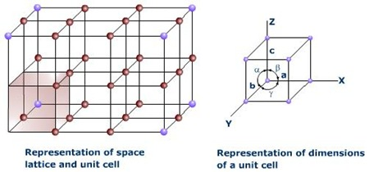
Lattice Parameters
The three sides of a unit cell are called the crystallographic axes. The angles between the three axes α, β and γ are called the axial angles.
The intercepts a, b, c define the dimensions of a unit cell and are known as lattice parameters of the unit cell.

Slide 4
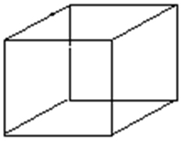
A parallelepiped shaped volume which reproduced by close packing in three dimension gives the whole crystal, is called the unit cell.

Slide 5

Primitive Unit cell
The unit cell occupying the smallest volume in a given lattice is called the primitive unit cell.
It contains only one lattice point.

Slide 6
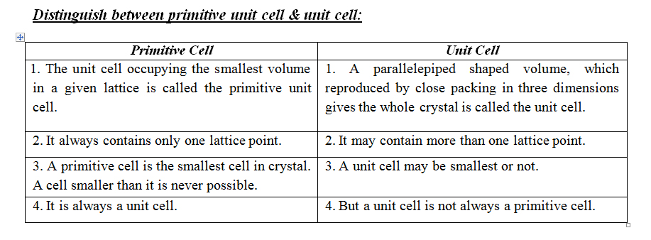
Non-Primitive unit cell: The unit cell which is larger than the minimum volume unit cell is defined as a non-primitive unit cell. A non-primitive unit cell contains more than one lattice point. The volume of a non-primitive unit cell is an integral multiple of a primitive cell.

Slide 7
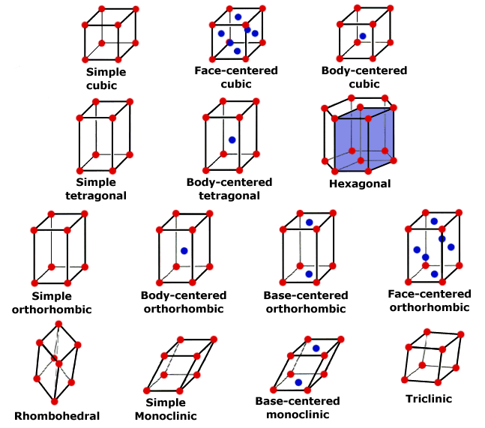
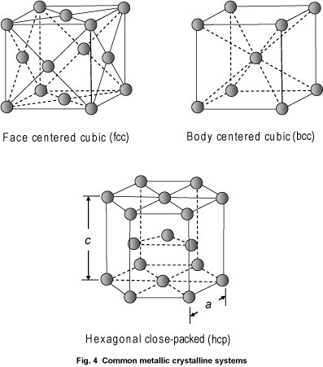
Lattice Symbols
‘P’: It means the primitive cell where lattice points are at the corners of the cell. A primitive cell is always a unit cell.
‘I’: It means the body centered lattice. In the body centered lattice, the lattice points are at the corners and inside the cell.
Simple cubic (sc)

Slide 8
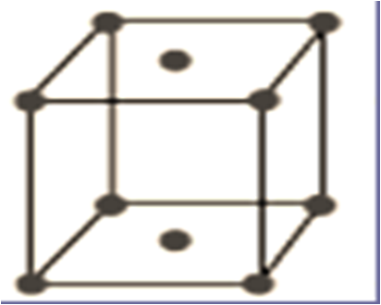
Lattice Symbols
‘F’: It means the face-centered lattice. In the face centered lattice, the lattice points are at the corners and all the faces centered.
‘C’: It means the lattice is base centered or C-face centered. In the base centered lattice, the lattice points are at the corners and at the face centered of opposite sides.
(bcc)

Slide 9
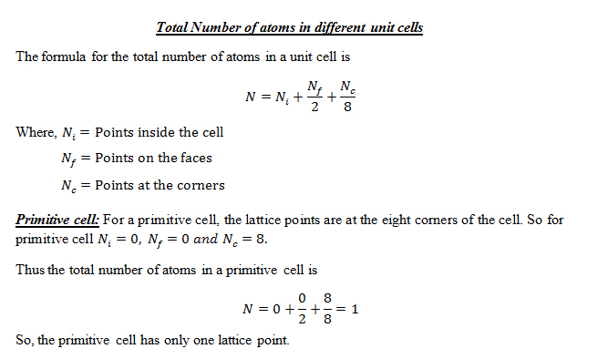

Slide 10
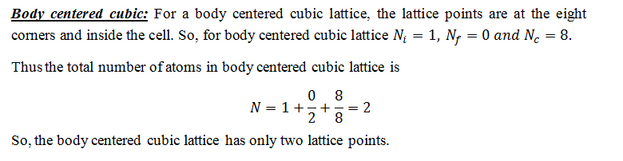

Slide 11
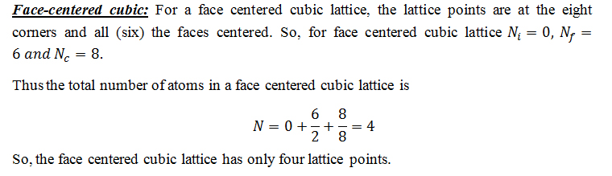

Slide 12
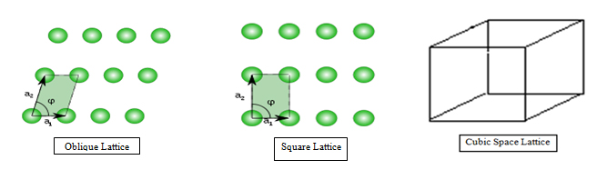
Bravais lattice: There are various ways of positioning points (lattice) in space such that all points have same identical surroundings, i.e. all points are of same kind and equivalent. These lattices are known as Bravais lattices. Bravais showed that, there exist no more than 14 space lattices in three dimensions. In order to specify the arrangements of points in a space lattice, he introduced 7-system of axes or crystal system.
Non-Bravais lattice: All points are not identical compared to each other known as non-Bravais lattices.

Slide 13
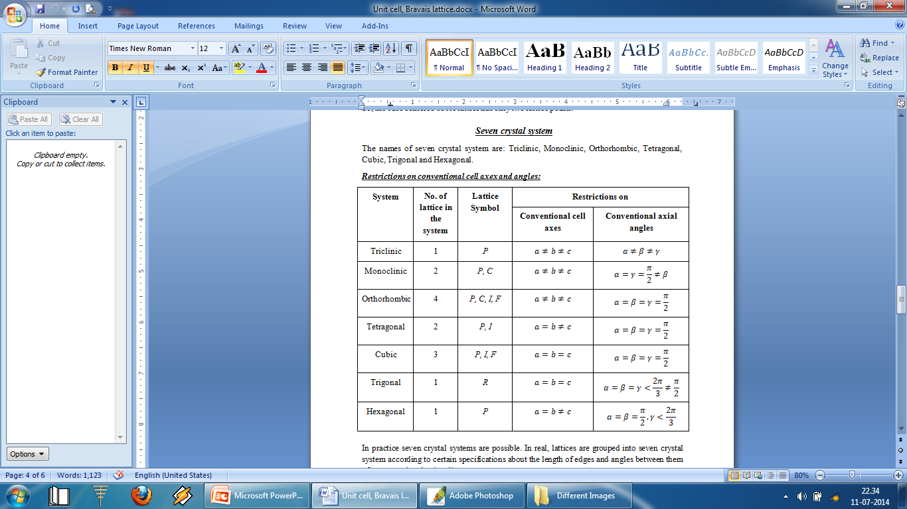

Slide 14

Triclinic: In the triclinic system, the single lattice type has a primitive unit cell (P) with three crystallographic axes of unequal lengths and unequal angles between them. i.e.
Monoclinic: In the monoclinic system, there are two lattice types: one with a primitive unit cell (P) and other with a non-primitive conventional cell which may be base centred (C) with the lattice point at the centre of the rectangular cell faces. Where

Slide 15

Orthorhombic: In the orthorhombic system, there are four lattice types: one lattice has a primitive unit cell (P), one lattice is base centered (C), one lattice is body centered (I), and one lattice is face centered (F). Here,
Tetragonal: In the tetragonal system, there are two lattice types: one is primitive unit cell (P) and another is body centered (I). In this case

Slide 16

Cubic: In the cubic system, there are three lattice types: the simple-cubic lattice (sc), the body centered cubic (bcc), and the face centered cubic (bcc).Here,
Trigonal: In the Trigonal system, a rhombohedron is usually chosen as the primitive cell. In this case

Slide 17

Hexagonal: In the Hexagonal system, the lattice is primitive and for this

Slide 18

Physics is hopefully simple but Physicists are not

